Slide 1
Simplified-Data Encryption standard (S-DES)
Submitted to:
Dr. Esraa Swillam
Eng. Sondos Shabana
Submitted by:
Fagr Ahmed Abd Elrazek “AUC section 12” ID:V23010586
Marwa Moaz “AUC section 14” ID:V23009897
Mohamed Yasser “AUC section 16” ID:V23010495
shurooq Mohammad Hassan Alshal “AUC section 12” ID:V23010529

Slide 2
Agenda
Introduction
DES
System Functionality
Behavioral stage
Final simulation results
Final simulation results
Completed the layout

Slide 3
Introduction

Slide 4
Introduction
Overview of the Data Encryption Standard (DES)
Explanation of encryption, decryption, and key generation and their roles in the design process
Behavioral stage and RTL for encryption, decryption, and key generation
Schematic and cell designs for each block
Final Results

Slide 5
DES

Slide 6
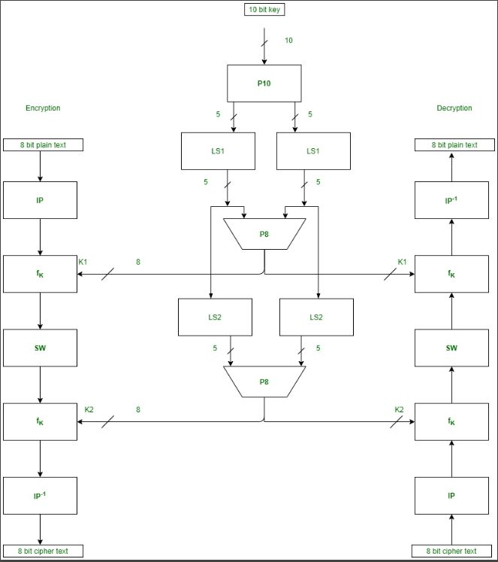
DES
DES is a block cipher with a 56-bit key length.
It encrypts data in blocks of 64 bits, producing a 64-bit ciphertext.
Despite its historical significance, DES has become less popular due to vulnerabilities to powerful attacks.
The same algorithm and key are used for both encryption and decryption, with a key length of 56 bits.

Slide 7
System Functinality

Slide 8
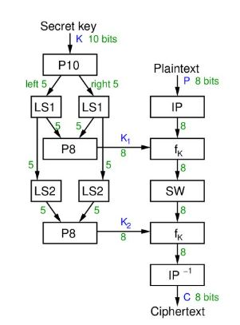
Encryption
DES encryption involves four functions:
IP
This step involves rearranging the bits of the plaintext according to a predefined permutation table.
FK
In this step, the subkey derived from the main encryption key is combined with the input data.
SW
In this encryption method, the data is divided into two parts, and the bits are swapped between them.
IP-1
the inverse of the Initial Permutation (IP) operation.

Slide 9
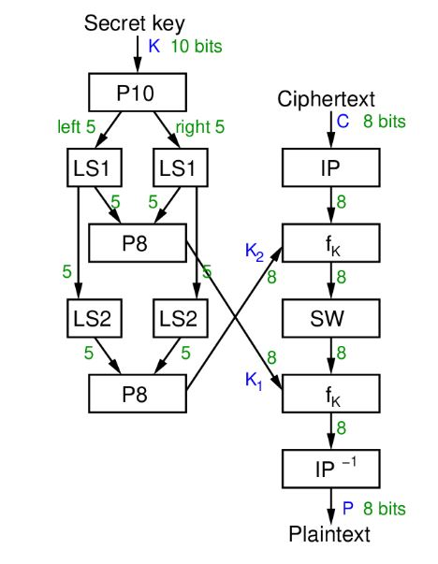
Decryption
in DES (Data Encryption Standard) involves reversing the steps of encryption

Slide 10
Key Generation
Involves creating the secret key used in the DES algorithm for encrypting and decrypting data.
In a simplified sense, for a 10-bit key, the key generation process would generate a set of subkeys needed for encryption and decryption.

Slide 11
Behavioral stage

Slide 12
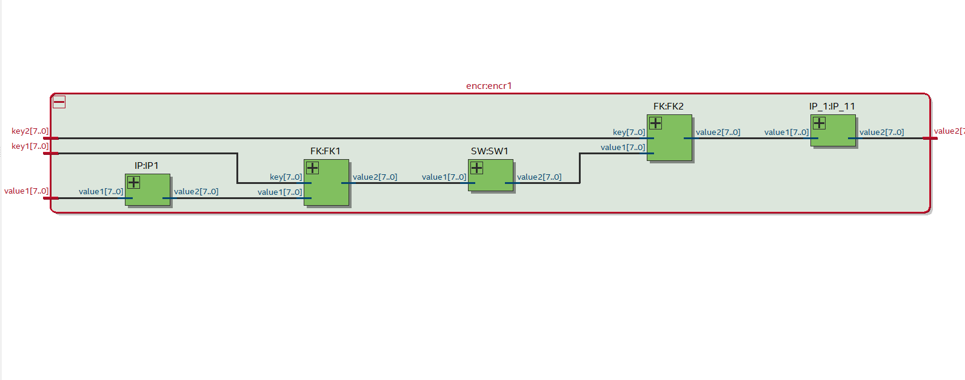
Encryption RTL

Slide 13
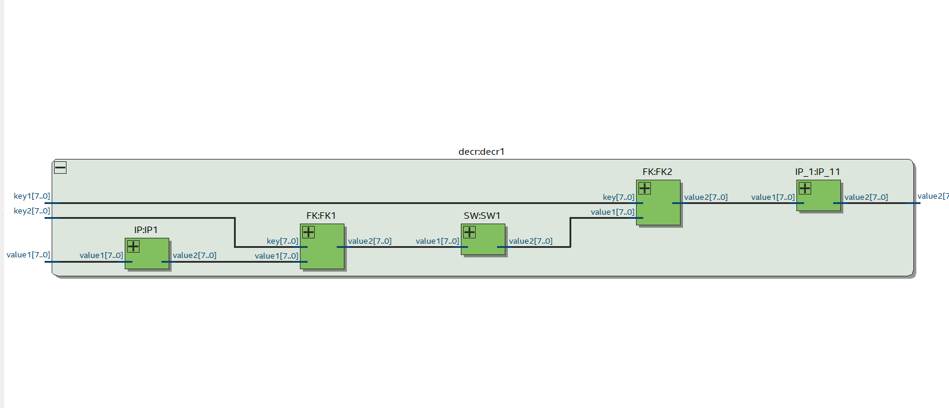
Decryption RTL

Slide 14
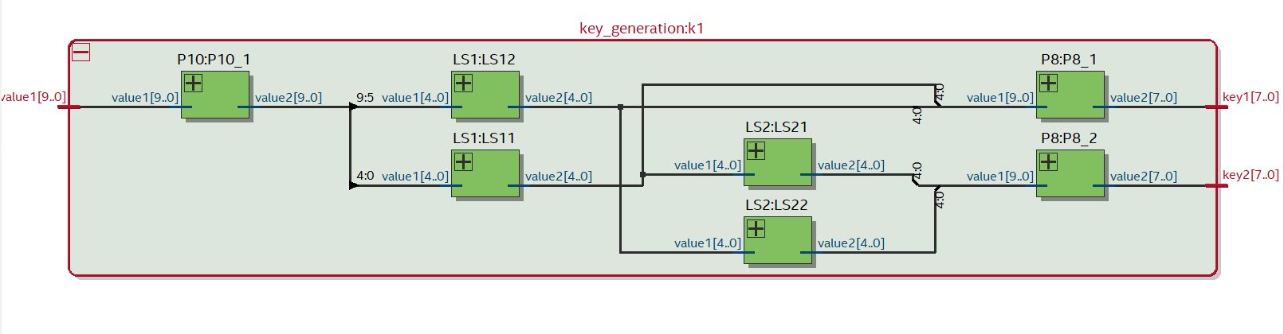
Keys RTL

Slide 15
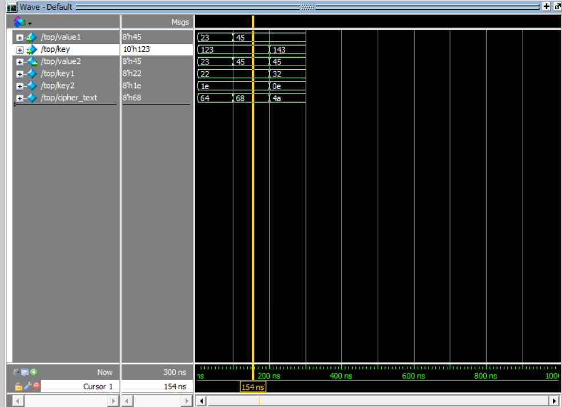
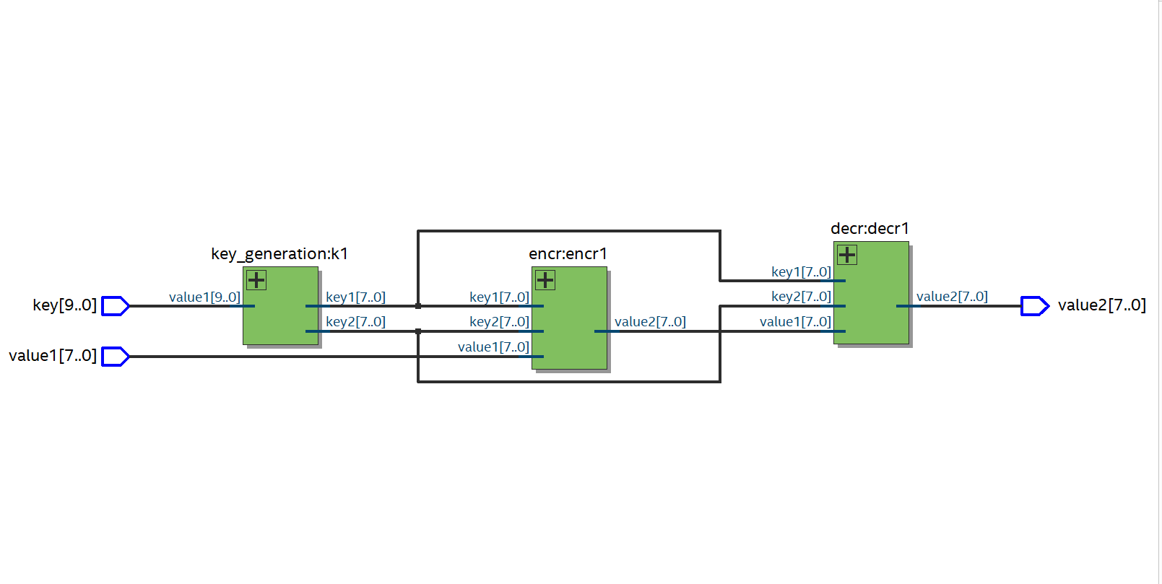
RTL Top Level and Wave

Slide 16
Results

Slide 17
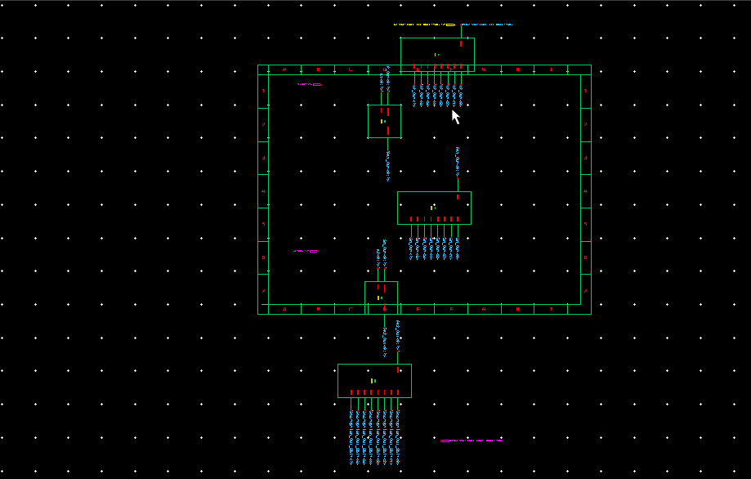
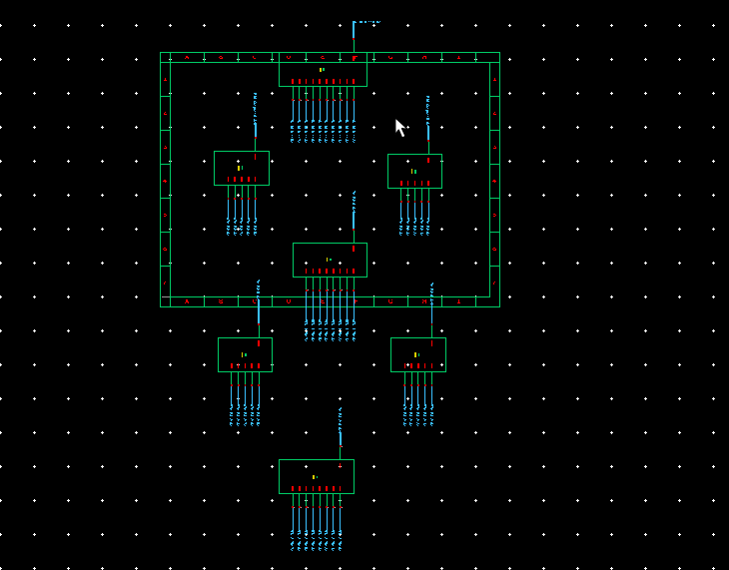
Encryption
Keys Generations

Slide 18
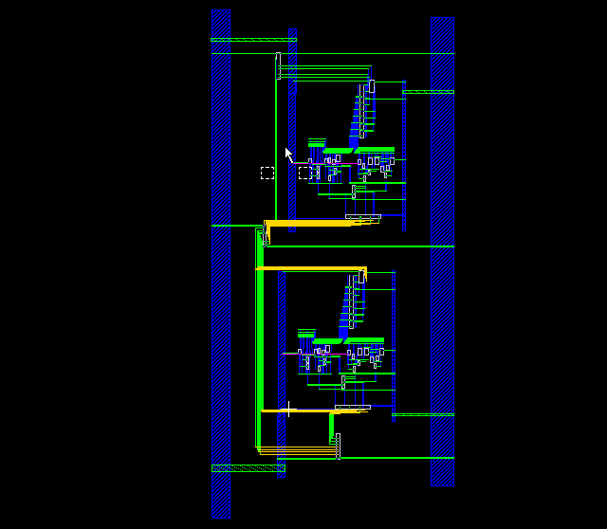
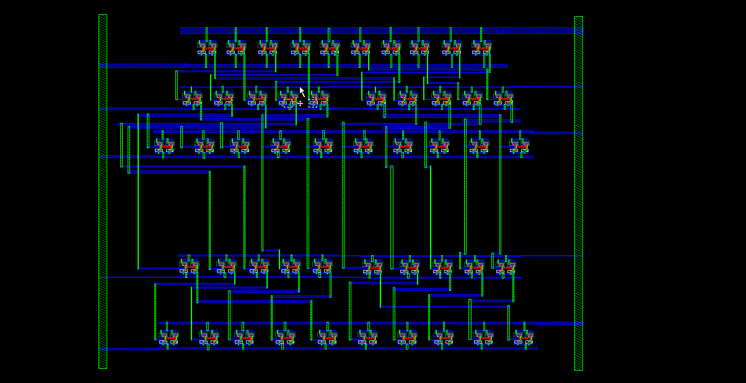
Encryption Layout
Keys Layout

Slide 19
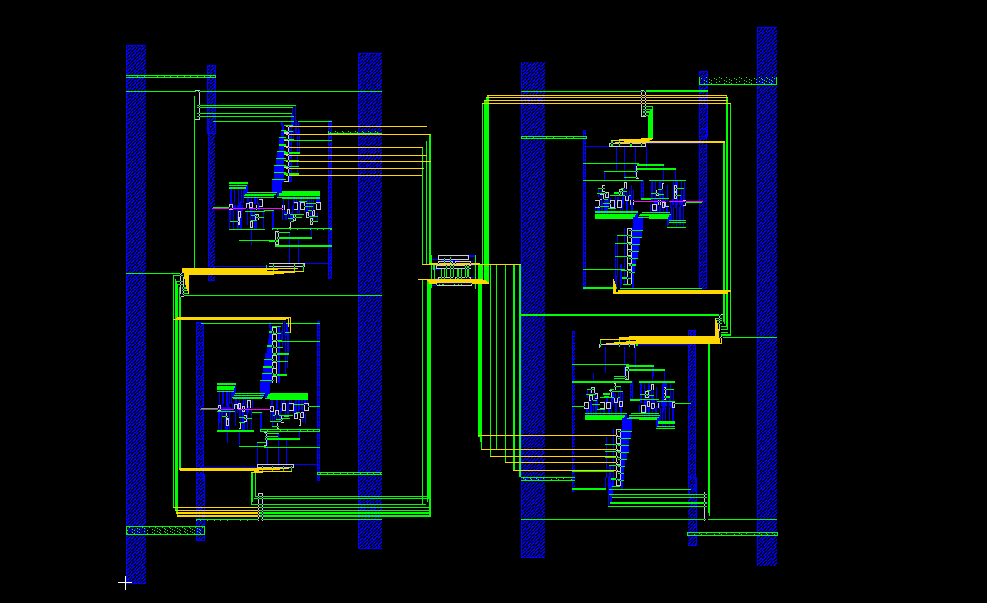
Final Layout

Slide 20
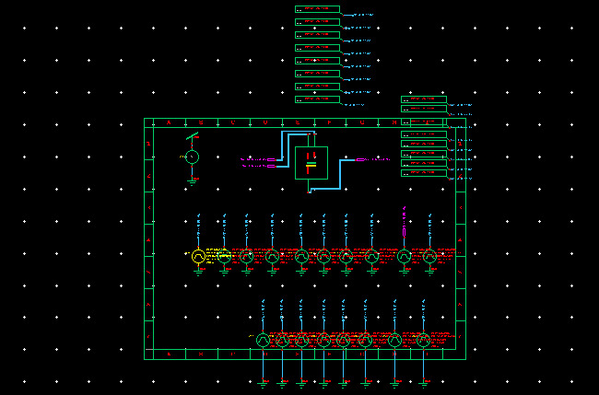
Testbench

Slide 21
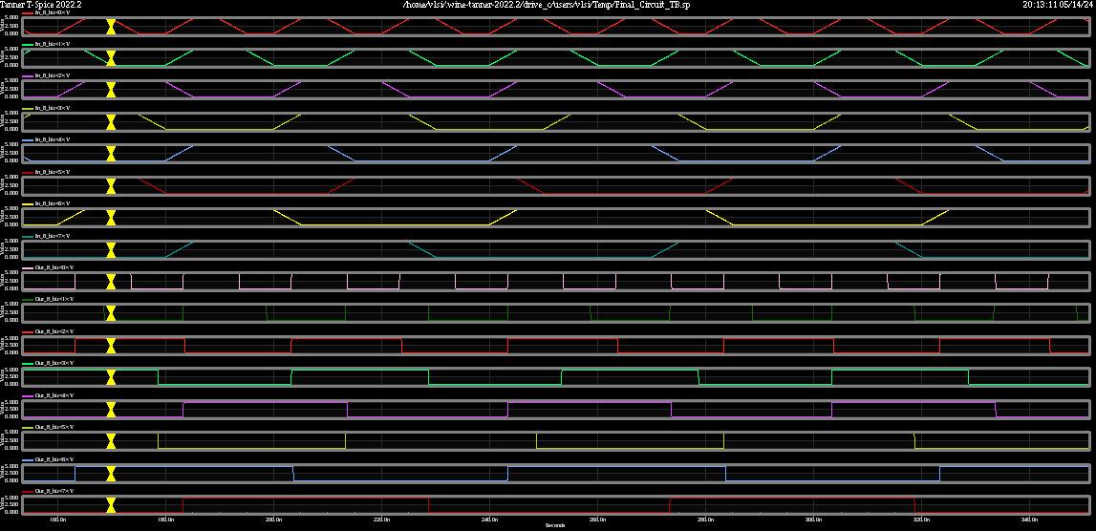
TB_output

